Slide 1
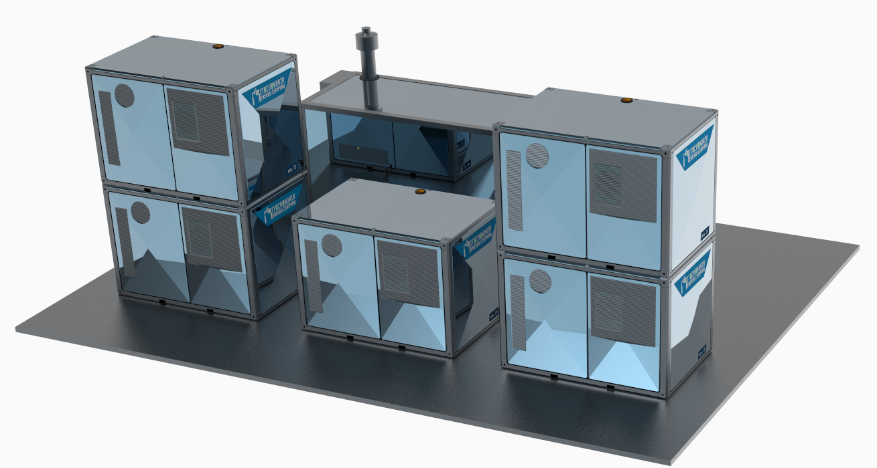
Energy Systems
Mitochondria Energy Systems- A New Era in Energy Generation
February 2022

Slide 2
Our Founding Philosophy
Energy Systems
The power system is embedded within the energy system, which in turn is embedded within the economy, society, the Earth systems and the cosmos. Multiple interactions and feedbacks between these systems require an integrated, holistic approach to the energy transition which should ultimately lead to regenerative / circular energy system which does not harm people nor the environment. This is just like the Mitochondrion, the 50 to 100 trillion energy system that powers the human body.
Welcome to the era of the Mitochondria Energy
Welcome to the era of the Prosumer
The Cosmic/
Ecological System
The Social System
Increasing
Ecological
Consciousness
The Energy System
Lack/ Absence of
Ecological
Consciousness
The Power System
The Economy
The Energy System
The Energy System
The Power System
The Power System

Slide 3
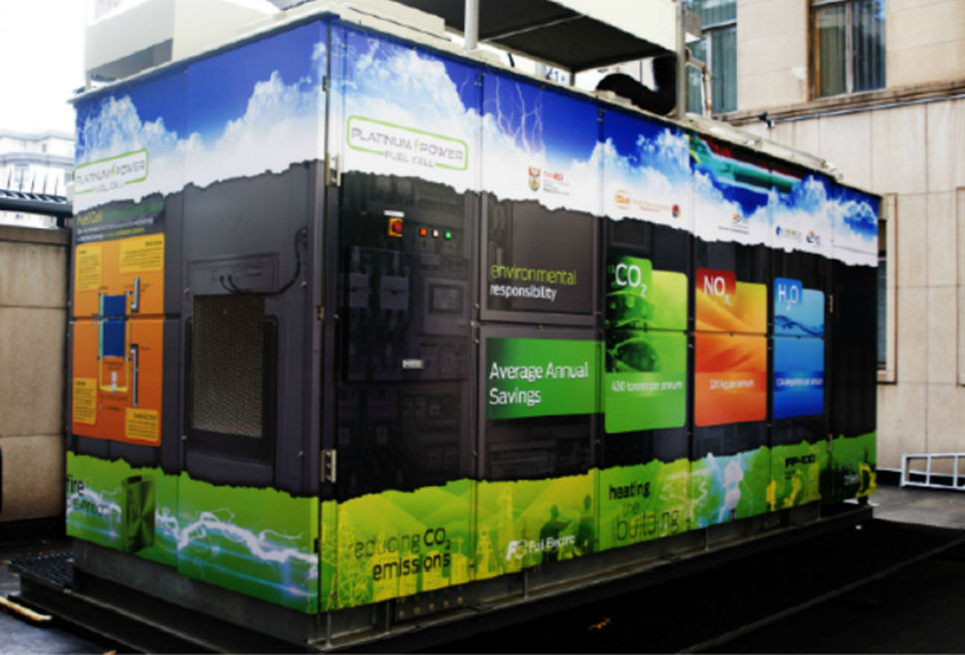
The Mitochondria Energy Group
Energy Systems
It is a well established assumption that energy is fundamental to the existence of all life in our planet and in fact it is so pervasive as to be the most visible reality in our universe which teems with billions and billions of stars constantly producing massive amounts of energy. Accepting what astrophysicists, astronomers and scientists have postulated, the universe comprises of approximately 75% of hydrogen. It is no wonder therefore that hydrogen is now emerging as the front runner of the global energy transition. Hydrogen is tipped to be the next dominant energy carrier to power the global economy. Our companies were established to power the hydrogen economy and make it a reality in the world. This is the foundation of Sustainable Ethical Solutions Holdings , the holding company of Mitochondria Energy Companies.
Rooted in the ethic and paradigm of sustainability, these companies were established to hold Mashudu Ramano’s interests in energy and water and comprises of four entities and a fund that is being established:
Mitochondria Energy company founded in 2012 to be an independent power producer focussing on distributed, decentralized and onsite energy solutions
Mitochondria Energy Systems founded in 2018 to develop and market hydrogen based energy technologies
Mitochondria Networks established in 2015 to provide smart energy network solutions.
Singamati (we are water) Holdings established in 2018 to provide water services from source to utilization and to support the hydrogen economy.
The Africa Hydrogen Economy Fund- In the process of being established to fund hydrogen related infrastructure and activities.
In 2014 Mitochondria Installed a 100KW Phosphoric Acid Fuel Cell at the Offices of the Minerals Council
of South Africa in Johannesburg

Slide 4
The Mitochondria Fuel Cell Video
Energy Systems
Video: https://youtu.be/egJb9HJIWaU

Slide 5
Hydrogen Valley Innovation Hub
Energy Systems
Hydrogen Valley Innovation Hub Goals
New Hydrogen Industry Establishment
Project Phoenix
NEW Industry formation
Re-Industrialisation towards a zero-carbon future
Just Energy Transition
Green Hydrogen Industries Value Chain $40bn by 2050
Global Competitive Fuel Cell Manufacturing Hub for local and exports
Electrolyser Manufacturing Hub for Green Hydrogen
Manufacturing Fuel Cell for Mobility Applications
Establish a critical Hydrogen Economy Working Group to Champion the development
First Fuel Cell Manufacturing Facility located within the VAAL SEZ to be named Hydrogen Valley Innovation Hub
Manufacturing Capacity 0e 250 MW to 1000MW/a capex of approx. R2bn
Job creation up to 400
Fuel cells to power the VAAL SEZ, Gauteng Provincial buildings and integrate with municipalities for own power generation
Project
Phoenix
Hydrogen Industry
Centre of Excellence
Re-Industrialise
Hydrogen Valley Launch
Supply Chain
Partnership
Project Phoenix Supply Chain Development
Centre of Excellence
Re-Industrialisation Existing Industry
R1.2bn per annum Local Supply Chain Development
250MW Inverter Manufacturing Facility R50m Investment
250MW Fuel Cell Stack Manufacturing R3bn Investment
Reformer Manufacturing Facility
Job Creation up to 1000 permanent jobs
VAAL Centre of Excellence focusing on the hydrogen economy knowledge and skills in partnership with VUT, FETs (Labs & Testing Facilities)
Provide skills upgrade to about 1000 job seekers to be employed in the Valley together with the Department of Labour / SETA’s
Job creation of up to 800 for fuel cell and electrolyser facilities
Towards a zero carbon future for:
Power Generation and Storage
Green Steel Production
Green Power Fuels
Diesel
Aviation fuel
Ammonia
SNG
Note: Reference to EU Hydrogen Valleys - https://www.h2v.eu

Slide 6
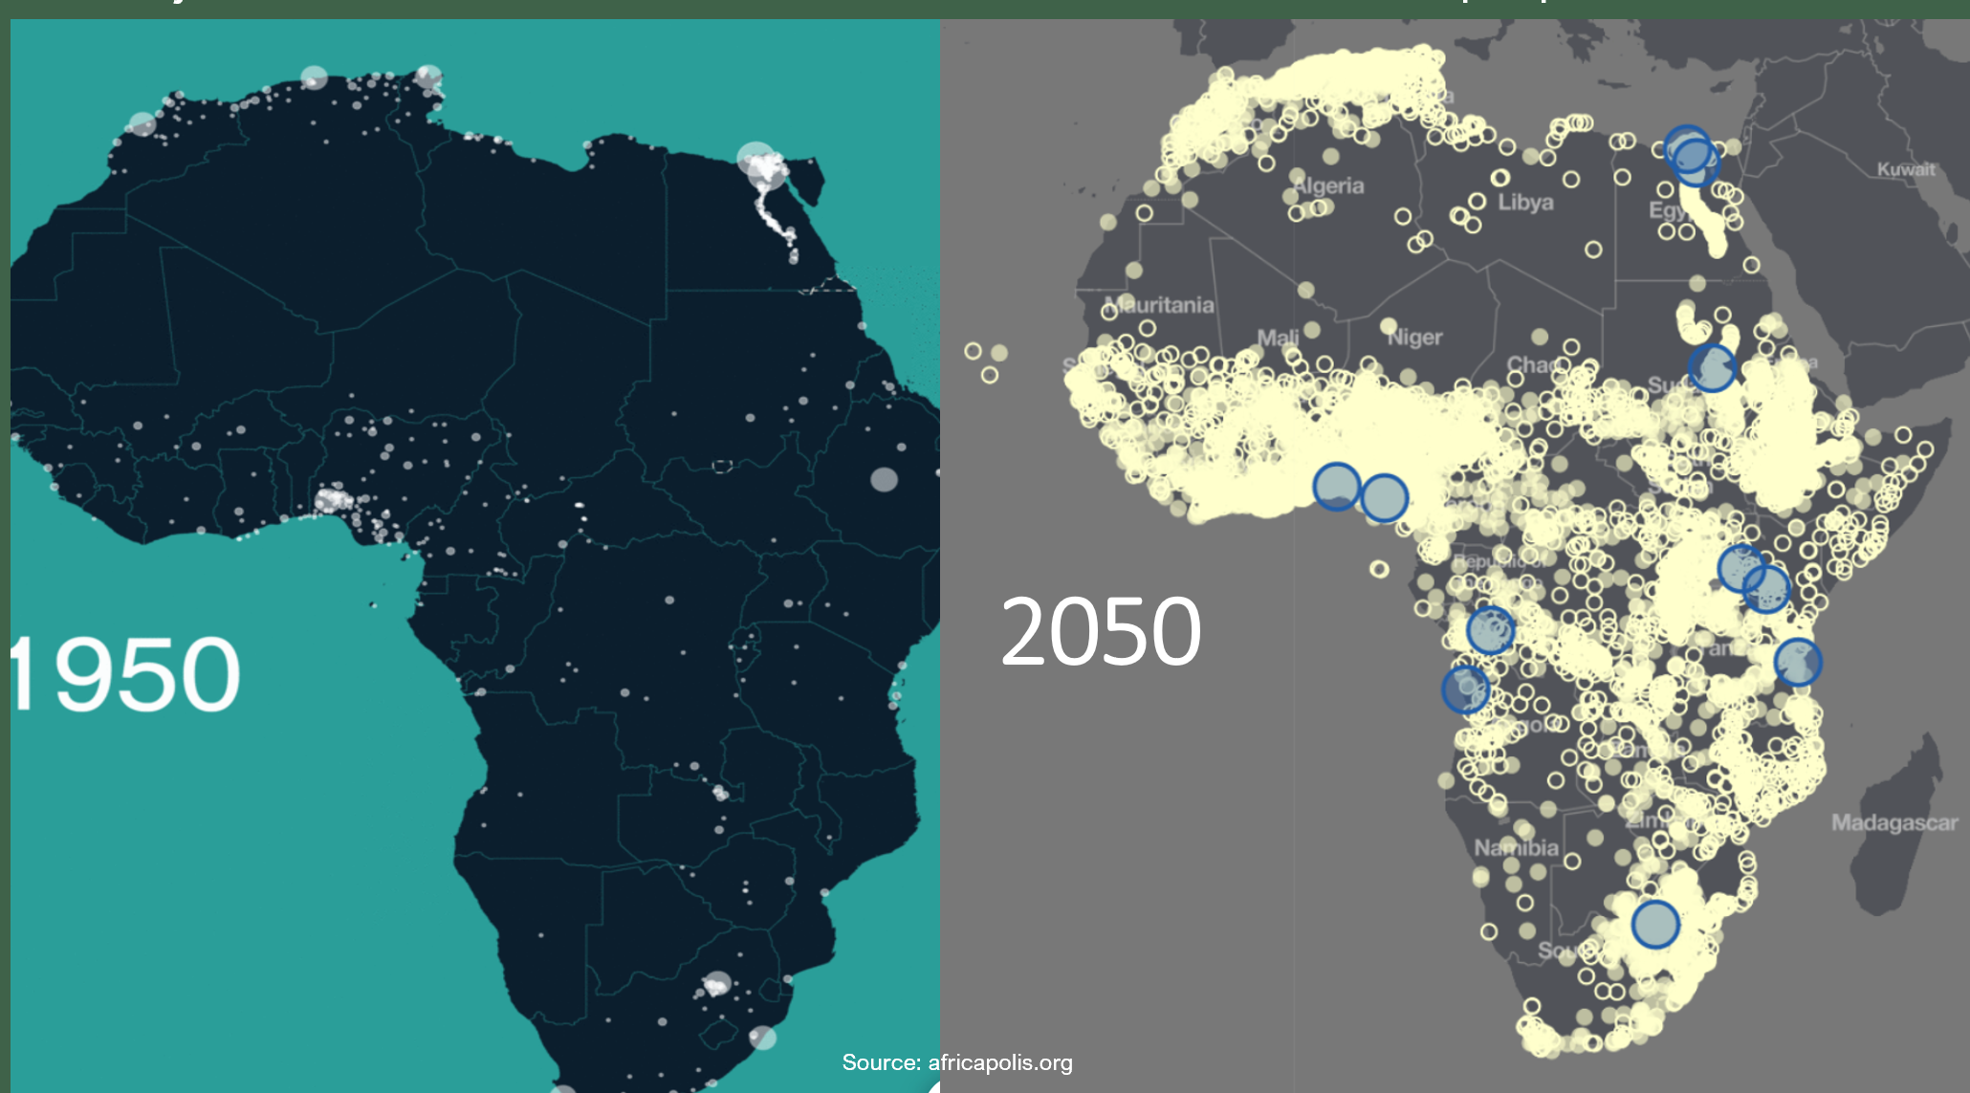
Our Ultimate Objective- Banish Energy Poverty in Africa and the World
Energy Systems

Slide 7
Funding Partners
Mitochondria Energy Partners
Energy Systems
Salient Points of Project Phoenix:
250 kW Fuel Cell product owned (IP) and developed by South Africans
Establishment of local fuel cell manufacturing facility
Specifically designed to address SA’s power crisis
Job creation: 400
Supply chain development: R1.2b p.a.
Request from European company for deployment in EU
Potential to be a significant player in global stationary fuel cell markets
Technical Partners
Land and Infrastructure Partners

Slide 8
Contact Details
Energy Systems

